Slide 1
Sharing our Joys and Sorrows
1st LISTENING GATHERING SYNODAL PATHWAY

Slide 2
MOMENT OF WELCOME
A warm welcome to everyone
We are all in the same boat – learning this together
Simple format for the evening
Listening to understand
Our role as Animators
Notes:
This should take five minutes – Connect to Diocesan symbol

Slide 3
MOMENT OF REFLECTION
Why are we here?
To plant dreams
To have a vision
To allow hope to flourish
To inspire trust
To bind wounds
To weave together relationships
To learn from one another
To create a bright resourcefulness that will
Enlighten our minds
Warm our hearts
And give strength to our hands
Notes:
From the Vatican preparatory document on the Synod

Slide 4
MOMENT OF INVITATION
You are warmly invited to:
Speak from the heart
To listen deeply to one another
To share your experience
To understand one another
To listen to God’s Spirit
Notes:
Take time to emphasise the importance of listening

Slide 5
MOMENT OF PRAYER
We begin our evening in prayer:
Using the ancient “Adsumus Sancte Spiritus” – “We stand before you, Holy Spirit - a prayer used for centuries at Church gatherings
A prayer that calls upon the Holy Spirit, inviting the Spirit into our conversations, opening us up to the way the Spirit works:
Let us stand to pray together slowly and deliberately:

Slide 6
Synod Prayer
We stand before you, Holy Spirit, as we gather together in Your name.
With You alone to guide us make Yourself at home in our hearts;
Teach us the way we must go and how we are to pursue it.
We are weak and sinful; do not let us promote disorder.
Do not let ignorance lead us down the wrong path nor partiality influence our actions.
Let us find in You our unity so that we may journey together to eternal life
and not stray from the way of truth and what is right.
All this we ask of You, who are at work in every place and time,
In the communion of the Father and the Son, forever and ever.
Amen

Slide 7
1st QUESTION FOR THIS EVENING
When you think about your experience of Church, what brings joy?
You are invited to reflect quietly about this before you respond
Music will play as we sit quietly
Notes:
Play background music perhaps Arvo Part

Slide 8
IN SMALL GROUPS
Your small group leader will invite you to share on the question for a
total of ………..minutes altogether.
When you think about your experience of Church, what brings joy?
Allow each person time to share
Listen to understand each other
When everyone has shared take time to write down, on a Post-It note, what you shared
Groups are invited to display the Post-It notes around the walls of the meeting space

Slide 9
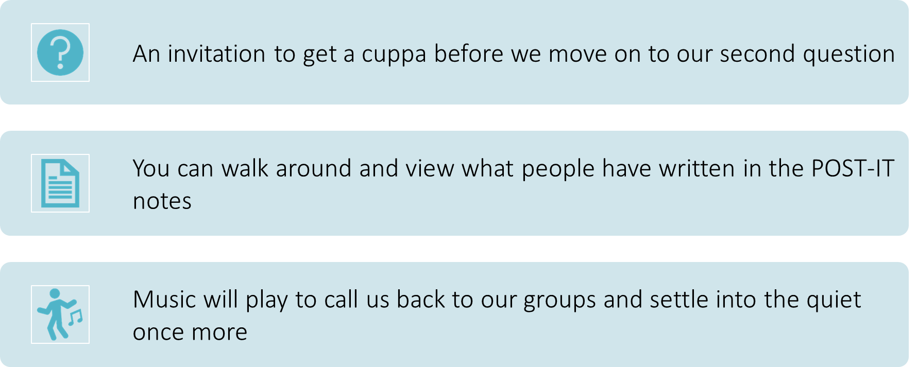
TEA BREAK
An invitation to get a cuppa before we move on to our second question
Music will play to call us back to our groups and settle into the quiet once more

Slide 10
BACK TO SMALL GROUPS – A SCRIPTURE REFLECTION
From the Gospel of Luke:
Now that same day two of them were going to a village called Emmaus, about seven miles from Jerusalem.
They were talking with each other about everything that had happened.
As they talked and discussed these things with each other, Jesus himself came up and walked along with them; but they were kept from recognizing him.
He asked them, “What are you discussing together as you walk along?”
They stood still, their faces downcast.
One of them, named Cleopas, asked him, “Are you the only one visiting Jerusalem who does not know the things that have happened there in these days?”
“What things?” he asked.

Slide 11
2nd QUESTION FOR THIS EVENING
When you think about your experience of Church what brings sadness or disappointment?
You are invited to reflect quietly about this before you respond
Music will play as we sit quietly

Slide 12
IN SMALL GROUPS
Your small group leader will invite you to share on the question for a total of
…….… minutes.
When you think about your experience of Church, what brings sadness or disappointment?
Allow each person time to share
Listen to understand each other
When everyone has shared take time to write down, on a Post-It note, what you shared
Groups are invited to display the Post-It notes around the walls of the meeting space

Slide 13
MOMENT OF THANKS
As we end this second listening experience I invite you
to listen carefully to these words from Vatican II document:
“Gaudium et Spes – The Church in the Modern World”
“The joys and the hopes, the griefs and the anxieties of the people of our time,
especially those who are poor or in any way afflicted,
these are the joys and hopes,
the griefs and anxieties of the followers of Christ”.

Slide 14
Thank you
For taking part
For listening well
For sharing openly
For taking the risk of opening your heart
Let’s pray the prayer that unites us……. OUR FATHER

Slide 15
Our Father who art in heaven,
hallowed be thy name.
Thy Kingdom come,
thy will done on earth as it is in heaven.
Give us this day our daily bread
and forgive us our trespasses
as we forgive those who trespass against us
and lead us not into temptation
but deliver us from evil.
Finally, I invite you to share a sign or gesture of PEACE…….
Thank you!

