Slide 1
Catholic Schools:
Communities of Faith and Resilience 1. Faith

Slide 2
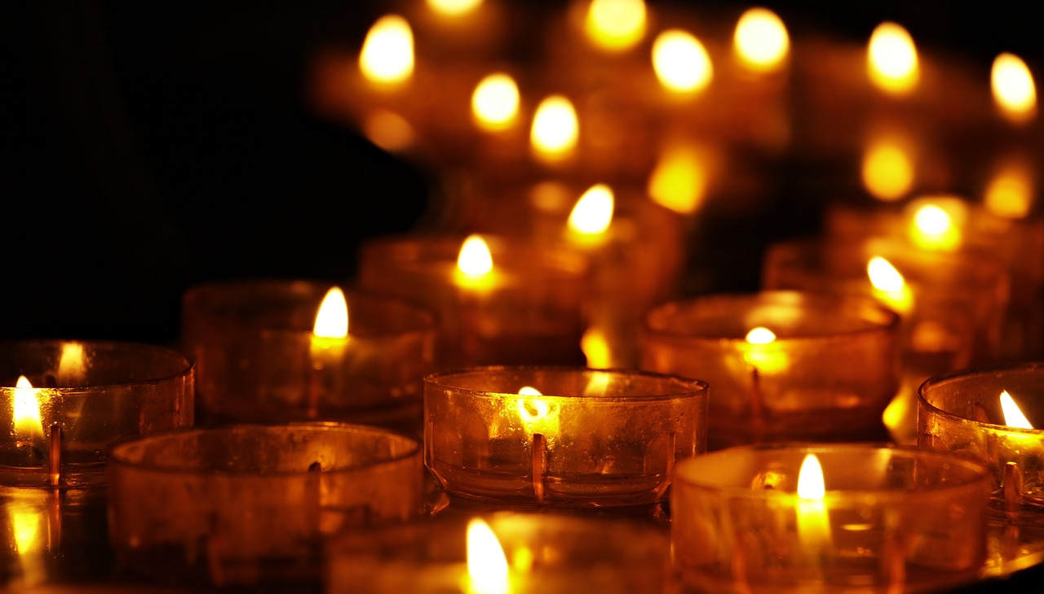
As communities of faith we work together to face our challenges − our individual flames contribute to a great light that shows us the way.
Notes:
Image by S. Hermann & F. Richter from Pixabay https://pixabay.com/photos/tea-lights-candles-candlelight-3612508/

Slide 3
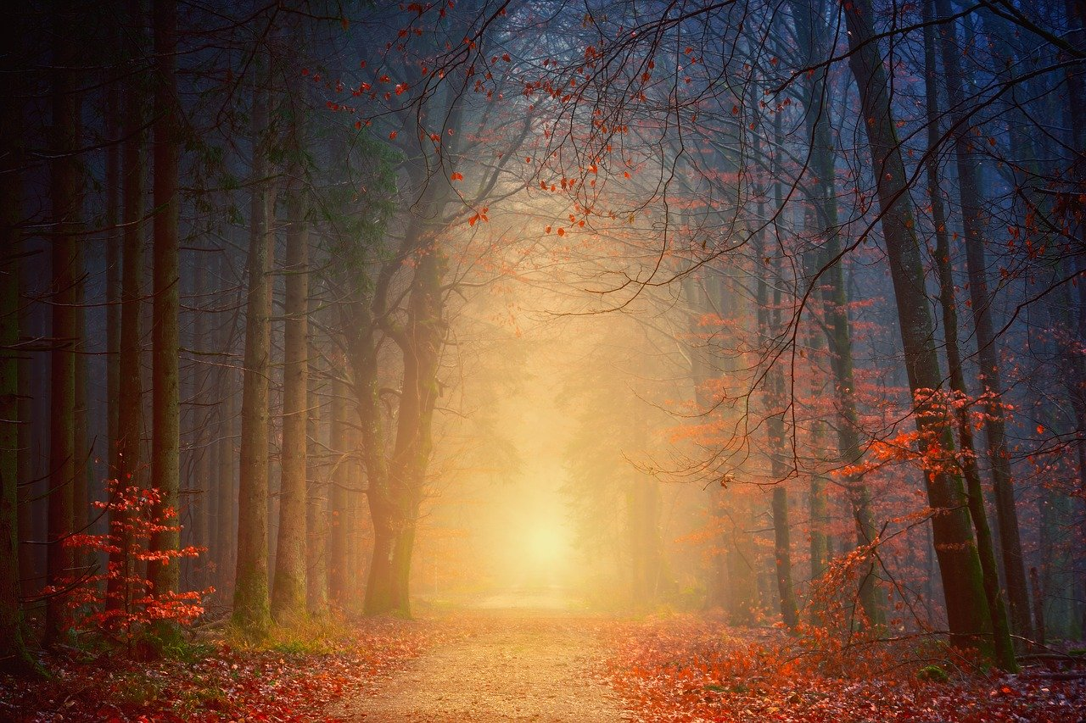
The light of Christ will guide us through the intriguing paths of life.
Notes:
Image by My pictures are CC0. When doing composings: from Pixabay https://pixabay.com/photos/away-forest-road-autumn-love-hope-4092262/

Slide 4
As communities of faith we are called to offer each other shelter, especially when we encounter challenges that are difficult to face.
Notes:
Image by Gerd Altmann from Pixabay https://pixabay.com/photos/umbrella-yellow-black-white-1588167/

Slide 5
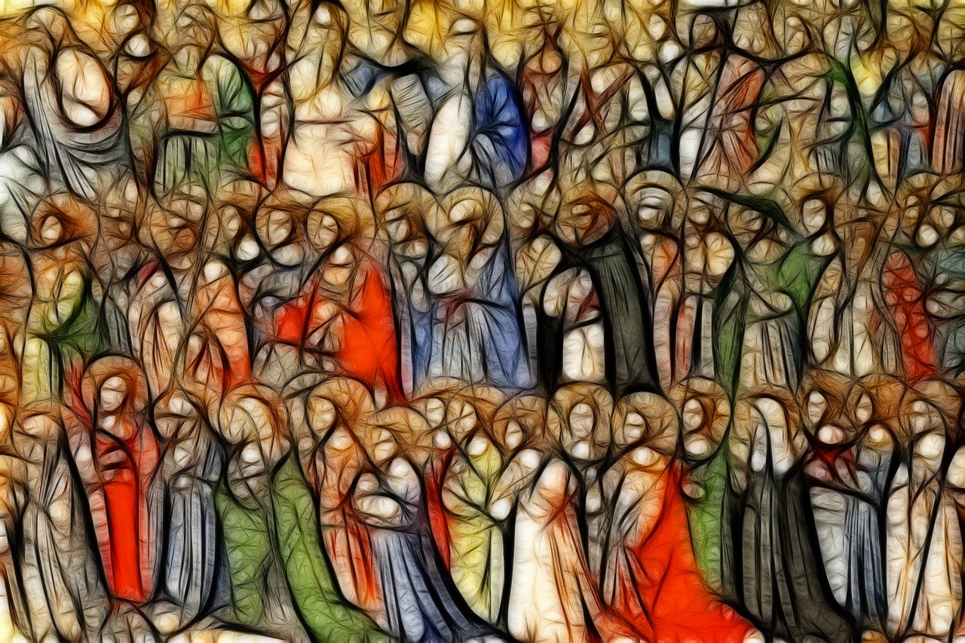
Our communities of faith include the living and those who have gone before us − they also can be called on in times of trouble.
Notes:
Image by Gerd Altmann from Pixabay https://pixabay.com/illustrations/all-saints-christian-holy-faith-2887463/

Slide 6
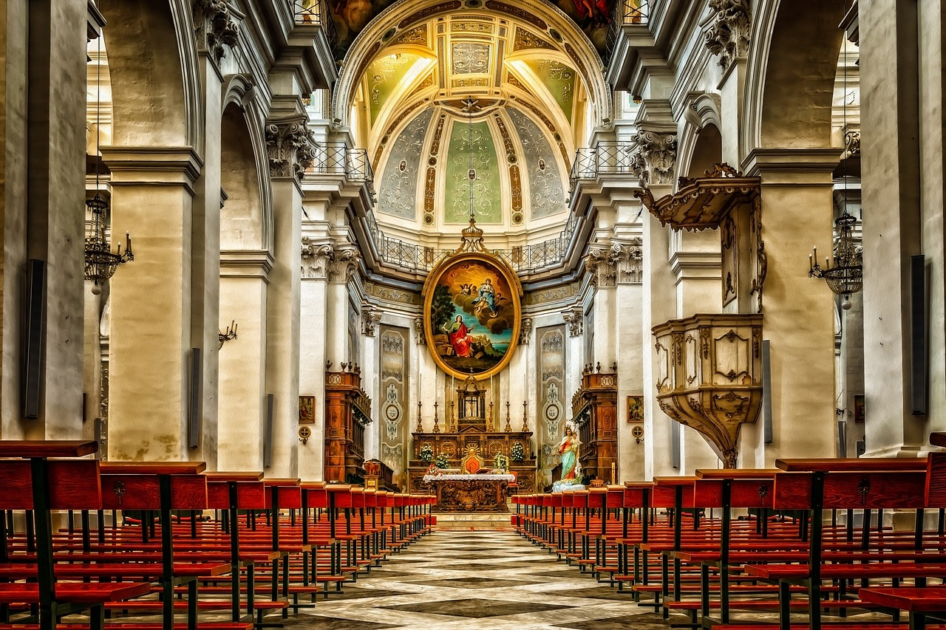
Even when our churches are closed or empty our faith tells us that Jesus is present − there and in the hearts of the faithful.
Notes:
Image by Peter H from Pixabay https://pixabay.com/photos/cathedral-church-dom-religion-3457933/

Slide 7
The beauty and order of creation draws us to God in faith and makes us aware of our responsibilities to the Earth, our common home.
Notes:
Image by 1239652 from Pixabay https://pixabay.com/illustrations/spiral-universe-space-creation-1037508/

Slide 8
When I find myself in times of trouble I can find comfort and direction in the Bible, but also I can engage with my faith community through electronic means.
Notes:
Image by congerdesign from Pixabay https://pixabay.com/photos/bible-iphone-mobile-phone-read-2690295/

Slide 9
‘Now, faith is the assurance of things hoped for, the conviction of things not seen.’ (Heb 11:1)

