Slide 1
On The Way to
Holy Communion

Slide 2
OUTLINE
FAMILY MEDITATION followed by quiet moment, chat and feedback
IDEAS FOR FAMILY ACTIVITIES followed by chat and feedback

Slide 3
Welcome Prayer
Be with us Lord as we journey together
and prepare as a family
for the special day of Holy Communion.
Help us to remember
you are always with us
as we journey to our special day.

Slide 4
On The Way To
Holy Communion
A FAMILY MEDITATION

Slide 5
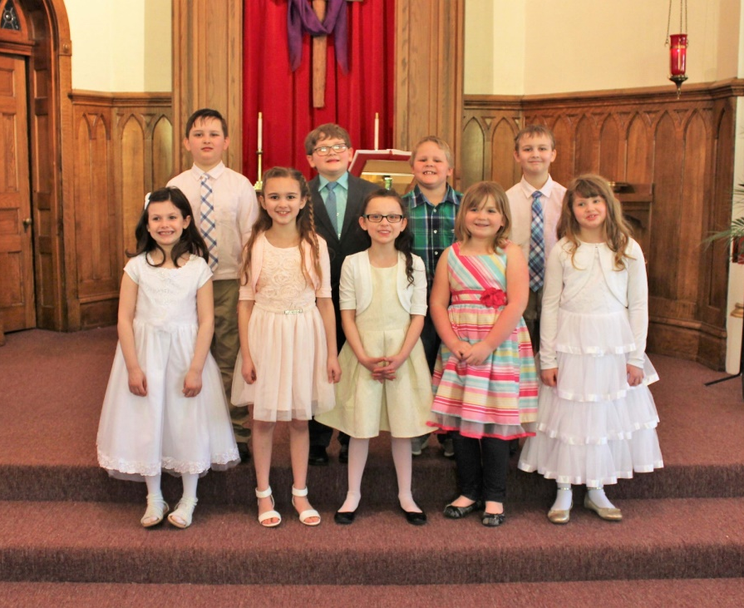
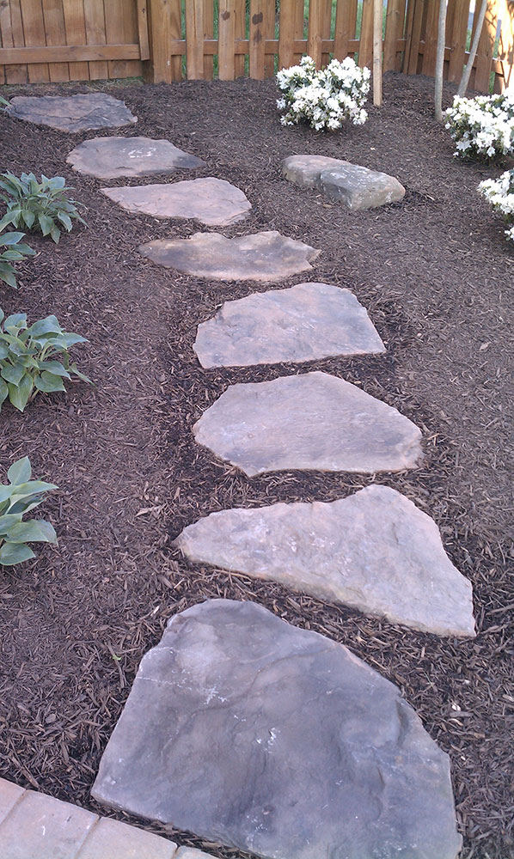
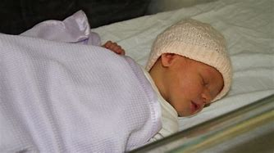
First Holy Communion
Is this the biggest day yet?
The biggest day since your child was born?

Slide 6
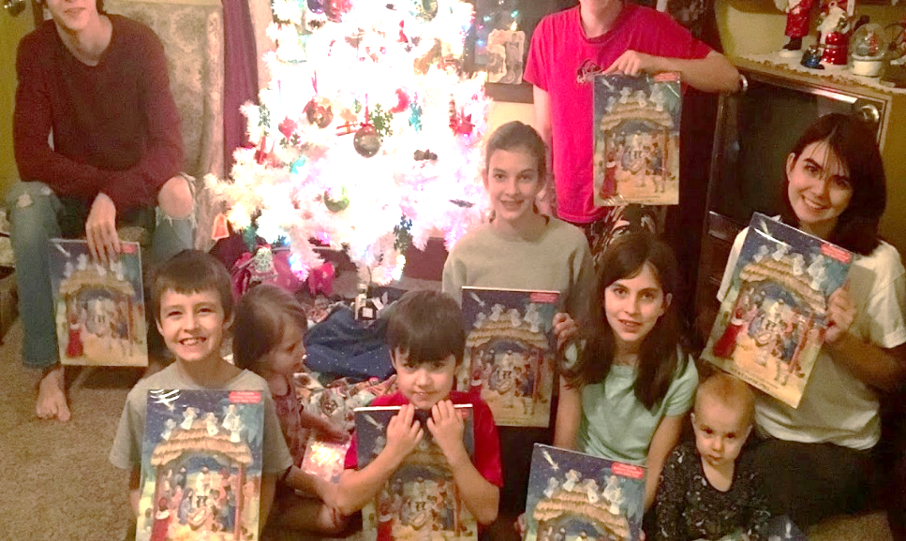
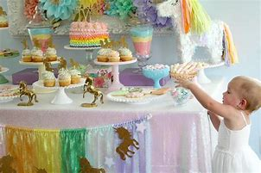
There have been other big occasions…
Christmas time
Birthdays every year
But many parents say that First Communion is even bigger in their family life.

Slide 7
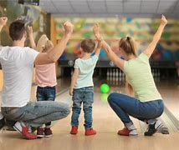
And lots of other great times, apart from big celebrations like birthdays and Christmas…
Remember a day you all went out somewhere?
Or something you did together as a family?

Slide 8
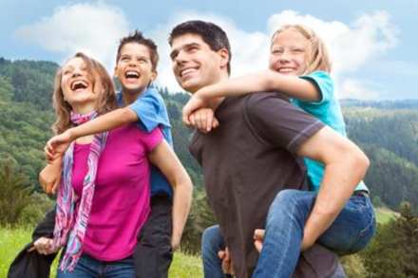
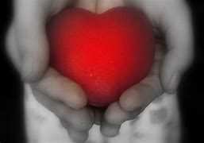
Times that are very ordinary and very special…
Perhaps captured in photos
Certainly held in your heart

Slide 9
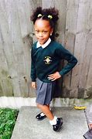
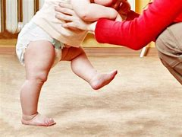
And the deep feelings that parents have as they watch their girl or boy growing up…
You’ll never forget their first day at school.
Or the first word they ever spoke.
Or the day they walked on their own two feet for the first time.

Slide 10
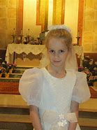
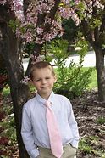
But First Communion day is very big
Part of it is that it’s more public.
There have been lots of great times in your family, your treasured memories.
But on this day you ‘go public’.

Slide 11
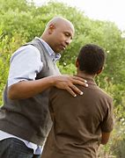

In the church, in front of everybody, you present your boy or girl for First Communion…
‘This is my son’.
‘This is my daughter’.

Slide 12
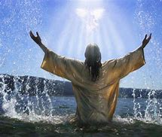
It’s like in the Gospels, at the Baptism of Jesus.
On that day, God the Father says;
‘This is my beloved’.

Slide 13
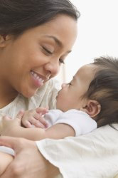
What God the Father says about Jesus, you say about your child
‘This is my beloved’.

Slide 14
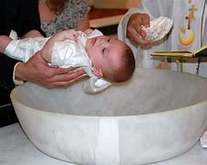
Is that why First Communion is such a big day?
Because it’s celebrating who this girl or boy is –
who they are as a person.
The last celebration like that was Baptism day.
When God the Father said to your child,
‘You are my beloved’.
Celebrating who this person is – held in love, a child of God.

Slide 15
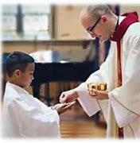
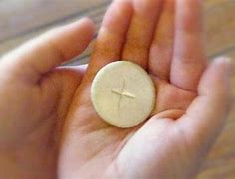
And now again at First Communion, a time to celebrate
You are special,
You are precious,
You are ‘beloved’.
It’s a huge celebration of your family
Of your family love, of all that you hold sacred.

Slide 16
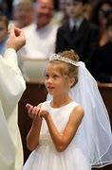
As you think of the years since your child was born,
there is so much to remember,
so much to appreciate,
so much to wonder at.
Now, at the First Communion Mass,
all this is “gathered up”
All of your family story…
All that means so much…
All the love, given and shared…

Slide 17
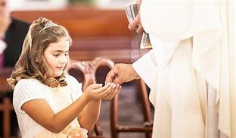
And you bring it all to God, with hearts full of thanks.
And as you do,
God in return says to your boy or girl;
‘I give all my love to you,
in Jesus,
as you receive
your first Holy Communion’.

Slide 18
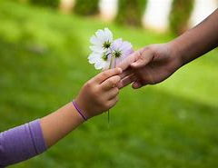
The heart of First Communion Day – the love of Jesus in your heart
For you to share with others
Your whole life through

Slide 19
Quiet Moment
What makes First Communion so special in our family?
CHAT AT HOME

Slide 20
Feedback
Would you like to say what makes First Communion so special in your family?

Slide 21
MENU OF FAMILY ACTIVITIES
These are some of the things you can do as a family to make the most of the time between now and your special day
Which ones would we love to do?

Slide 22
ACTIVITY 1: SHARING MEMORIES OF SPECIAL FAMILY MEALS
Have a family chat to share memories of special family meals you have had.
What was your favourite one?
When will we have the next one?
Prayer to say
Dear God, thank you for our special times together.
When we share a meal together, we share our love for each other.
We look forward to First Communion,
the Mass where you share your love for us
as you give your son Jesus to us.

Slide 23
ACTIVITY 2: FIVE FINGER PRAYER Say Pope Francis’ ‘5 Finger Prayer’ together
Our thumb is closest to our heart
  Pray for the people close to your heart, your family and your friends, the special people in your life
Our forefinger gives directions
  Pray for people who lead us and point us in the right direction, teachers in school, coaches in sport, doctors/nurses
Our middle finger is the tallest
  Pray for our leaders who guide us, pray for God to guide them and make them wise and strong
Our ring finger is the weakest
  Pray for the weakest people in our society, people who are ill or suffering, poor and struggling
Our little finger comes last
  When we have prayed for other people, we pray for ourselves as well
  We pray for God’s care and protection and strength

Slide 24
ACTIVITY 3: VISIT THE CHURCH
Visit the church together.
Find out when it is open during the day.
It is a lovely quiet place to sit.
Make the sign of the cross.
Take time for that special prayer, where you’re still and silent,
and you know that God is there with you.
Light a candle and pray for special people and special intentions.
Say the ‘Glory be…’ prayer together.
Visit again, as often as you like – you are always welcome; this is always your place!

Slide 25
FEEDBACK
Any questions
Parish Information

Slide 26
CLOSING PRAYER
Bless our family Lord and all those we love.
Help us to remember that you are always with us every day.
Give us grateful hearts as we journey on our way
to a very special day.

